Slide 1


Natural language Models
Dayananda Sagar University
School of Engineering
Devarakaggalahalli, Harohalli Kanakapura Road, Ramanagara, Karnataka 562112
Department of Computer Science & Engineering
(Artificial Intelligence & Machine Learning)
SEMESTER – VI
Course Code: 22AM3610
Review 1: Mini Project
Title: LLM-Powered Currency Denomination and Counterfeit Detection System
Under the guidance of
Prof. Pradeep Kumar K
Prof. Sahil Pocker
Team Member
Deekshitha M (ENG22AM0010)
Gaana Shree S (ENG22AM0014)
Gayatri Govinda Setty (ENG22AM0017)
Kara Swathi (ENG22AM0027)
Date: 28/03/2025

Slide 2
Contents
SDG Goals
Introduction
Literature Survey
Problem Definition
Objectives
Methodology
Conclusion
References
Acknowledgments

Slide 3
SDG Goals
SDG 16: Peace, Justice, and Strong Institutions.
The proliferation of counterfeit currency undermines economic stability, fuels transnational crime, and erodes public trust in financial institutions.
The ability of LLMs to analyze financial data and identify anomalies promotes transparency and accountability in financial systems. By detecting fraudulent activities and counterfeit currency, our project helps to reduce illicit financial flows, a key target of SDG 16, and builds trust in financial institutions.

Slide 4
Introduction
Large Language Models, like FinBERT and GPT-2, dissect financial texts. FinBERT identifies domain-specific fraud patterns, while GPT-2 spots narrative anomalies, improving fraud detection accuracy.
These models surpass traditional methods by detecting semantic and stylistic irregularities in financial reports. This enhances fraud detection, securing financial stability and reinforcing institutions, vital for SDG 16.
Extending this, LLMs analyze banknote text and visuals. By identifying inconsistencies between printed text, security features described in text, and visual elements, LLMs aim to refine counterfeit detection, strengthening economic security.

Slide 5
Literature Survey
Author(s) | Title | Year | Methodology | Key Findings | Limitations
Chethana GH , Dhruva DK, Gagana KN , Rohith MS , Dr. P S Puttaswamy | Fake Currency Detection Using Machine Learning | 2024 | Advanced approaches integrating Convolutional Neural Networks (CNNs)s into counterfeit detection system. | Neural network | Only detection of currency is being implemented , does not give any information about the country.
MRS. Sonali B.Kanawade,Sammed S.Jangade,Abhishek R.Mane,Tejas D.Kurne | Counterfeit Currency Detection Using Machine Learning | 2024 | Large Language Model (LLM) for Multimodal Learning or CNN-based Models: Used for deep learning-based image classification of real vs. fake currency. Model Training and Evaluation: Supervised learning | Large Language Models

Slide 6
Literature Survey
Author(s) | Title | Year | Methodology | Key Findings | Limitations
Manya,Vinay Kukreja, Shiva Mehta, Sonali Gupta, Ashish Garg | Financial Foresight: Predictive Power of CNN-SVM in Fake Currency Detection Analysis | 2024 | The CNN-SVM model was thoroughly trained and tested using a 6500-picture dataset that included actual cash and counterfeit notes. Consequently, it attained an excellent overall accuracy of 97.2071%. For every class, the accuracy recalls and F1-score of the model were calculated with precision. | Large dataset which let to the accuracy of 97.2%. | Only detection of currency is being implemented , does not give any information about the country.
Aneena Babu, Vinetha Sankar | Fake Indian Currency Detection | 2024 | Solution leveraging advanced image processing and computer vision techniques to detect and neutralize counterfeit notes. Counterfeiting currency poses a genuine menace to both the populace's well-being and the nation's economic stability. | Image processing, feature extraction | Brute force matcher

Slide 7
Problem Definition
Our project aims to investigate the feasibility and effectiveness of leveraging Large Language Models (LLMs) to enhance fake currency detection systems by developing a model capable of analyzing textual and visual features of banknotes, extracting relevant security information, and identifying anomalies indicative of counterfeiting.

Slide 8
Objectives
LLM-Based Classification:
Leverage an LLM to analyze textual and visual patterns to accurately classify currency denominations.
Counterfeit Detection:
Build a robust detection algorithms within the LLM framework to reliably identify counterfeit notes.
Real-Time Verification:
Develop an interactive web application that enables users to scan and authenticate currency instantly using AI-driven analysis.

Slide 9
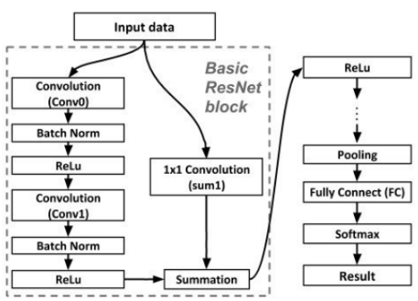
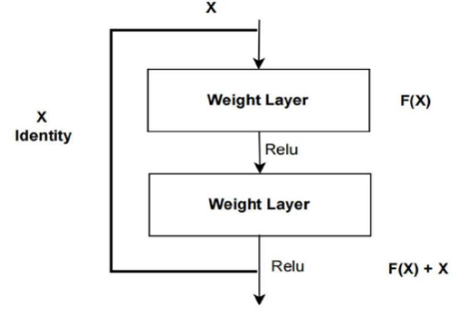
Methodology
Public Datasets: Existing datasets of banknotes from different countries, including both genuine and counterfeit notes.
Large Language Model (LLM) for Multimodal Learning or CNN-based Models: Used for deep learning-based image classification of real vs. fake currency.
Model Training and Evaluation: Supervised learning

Slide 10
Conclusion
The solution delivers an AI-based system for currency verification and counterfeiting detection employing LLM.
The purpose is to secure effective and trustworthy currency verification with organized denominations and live verifications.
It will increase security in finance through reduced frauds and enhanced correctness in authentication.
The proposed outcome is an expandable, dependable solution facilitating streamlined currency validation and trust within transactions.

Slide 11
References
Ledig, C., Theis, L., Huszár, F., Caballero, J., Cunningham, A., Acosta, A., ... & Shi, W. (2017). Photo-realistic single image super-resolution using a generative adversarial network. In Proceedings of the IEEE conference on computer vision and pattern recognition (CVPR) (pp. 105-114).
“Transfer Learning in Endoscopic Imaging: A Machine Vision Approach to GIT Disease Identification”, 2024 1st International Conference on Communications and Computer Science (InCCCS) | 979-8-3503-5885-8/24/$31.00 ©2024 IEEE | DOI: 10.1109/InCCCS60947.2024.10593269 , 979-8-3503-5885-8/24/$31.00 ©2024 IEEE
Zhang, Y., & Patel, V. M. (2019). D3SR: Deep single image super-resolution with dilation-based dense skip connections. In Proceedings of the IEEE conference on computer vision and pattern recognition (CVPR) (pp. 446-455).
Wang, Z., Chen, J., Hoi, S. C., & Wang, P. (2020). Deep multi-branch generative adversarial networks for image super-resolution. IEEE Transactions on Pattern Analysis and Machine Intelligence (TPAMI), 42(11), 2864-2879.
J.C. Gillette,T.M. Stadtmiller and Hardie R.C., Aliasing reduction in staring infrared imagers utilizing subpixel techniques, Optical Engineering, 34 31-37.
J. Sun, N. Zheng, H. Tao and H.Y. Shum.: Image hallucination with primal sketch priors, in IEEE Int. Conf. on Computer Vision and Pattern Recognition, 729–736, 2003.

Slide 12
Acknowledgments
Grateful appreciation to Prof. Pradeep Kumar K and Prof. Sahil Pocker for their invaluable guidance, support, and mentorship throughout this project.
Special thanks to the Reserve Bank of India’s Third Global Hackathon for providing the problem statement that inspired this research.

